Slide 1
Chapter 0: Computer System Architecture For OS

Slide 2
Computer System Architecture
Prerequisite for OS & Parallel Computing
Reference: Morris Mano “Computer System Architecture”, 3rd Edition

Slide 3
Content
Transistor: Semi-conductor
Digital Circuit
Logic Gate
Digital Component
Register
Memory
Bus
Central Process Unit
Instruction
Computer Operation
I/O Interrupt
DMA

Slide 4
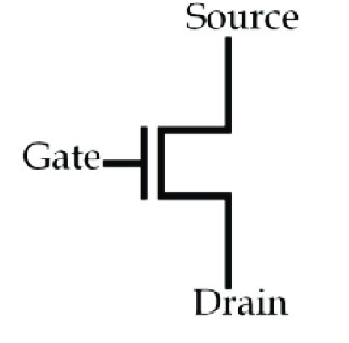
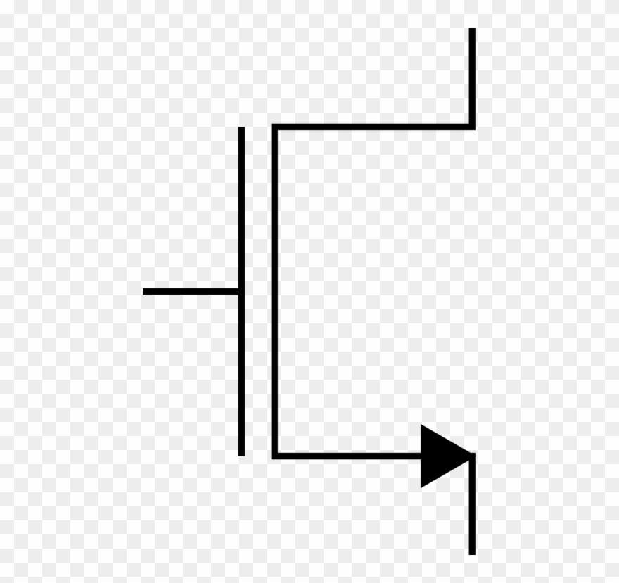
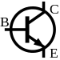
Transistor
Symbol
N-type metal-oxide-semiconductor logic
V_{BE}(Voltage) | I_{CE}(Current)
1 (voltage) | I_{CE} through CE (Short circuit)
0 (voltage) | No I_{CE} through CE (CE is broken)
Bipolar junction transistor (BJT)

Slide 5
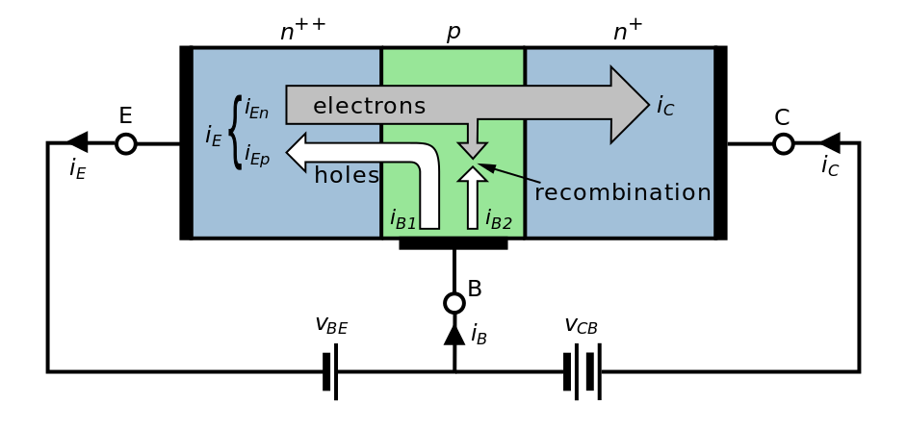
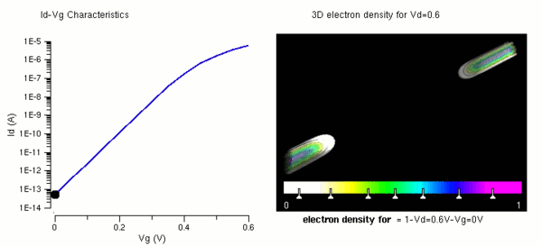
Transistor
Transistor
V_{BE}(Voltage) | I_{CE}(Current)
1 (voltage) | I_{CE} through CE (Short circuit)
0 (voltage) | No I_{CE} through CE (CE is broken)
Notes:
Avalanche

Slide 6
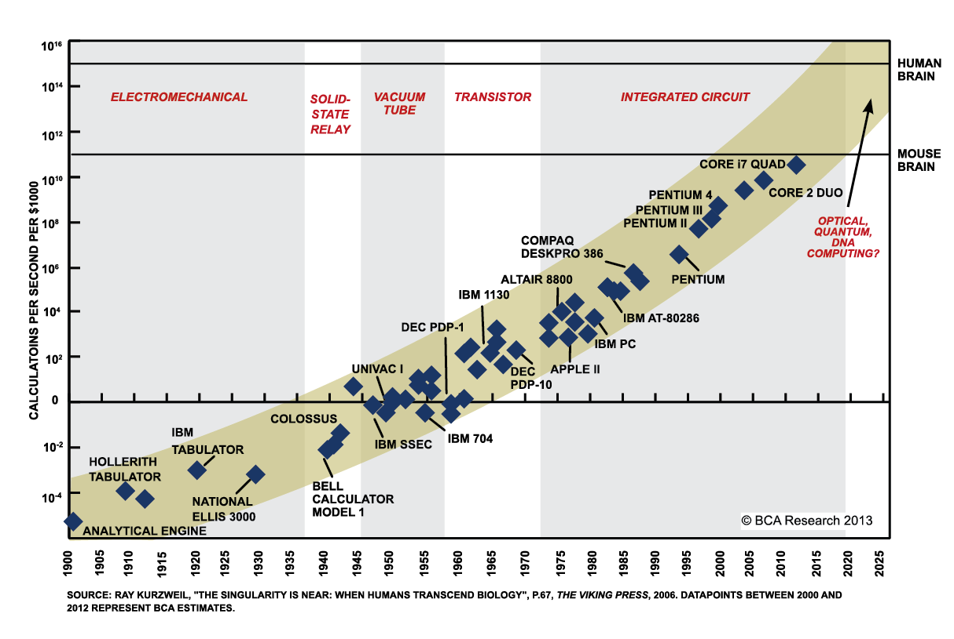
Moor’s Law
The number of transistor on an IC would double every 18 months

Slide 7
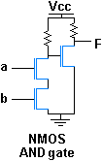
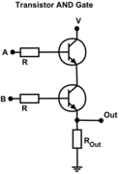
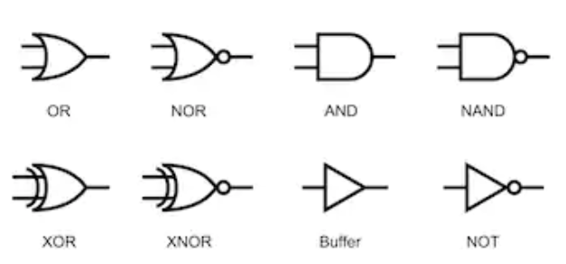
Logic Gate
Logic Gate

Slide 8
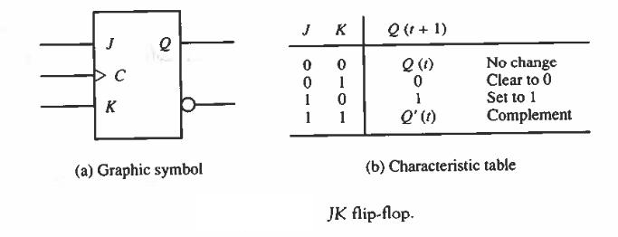
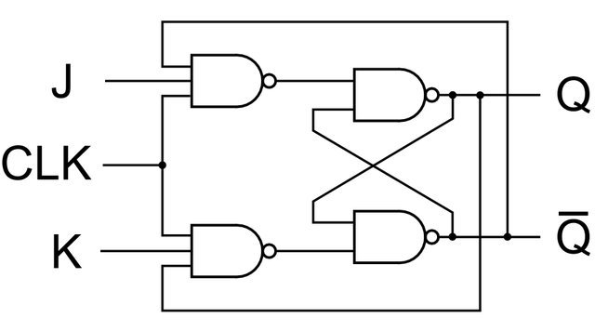
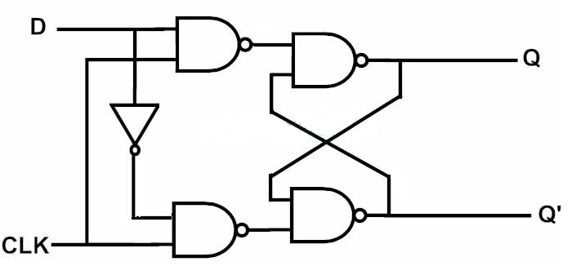
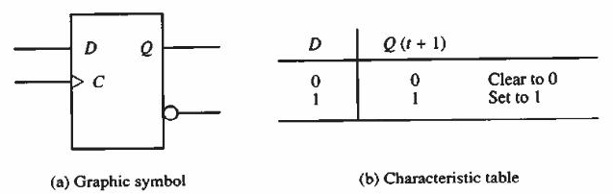
Digital Component
Flip-Flop: Consists of Register (state-related component)

Slide 9
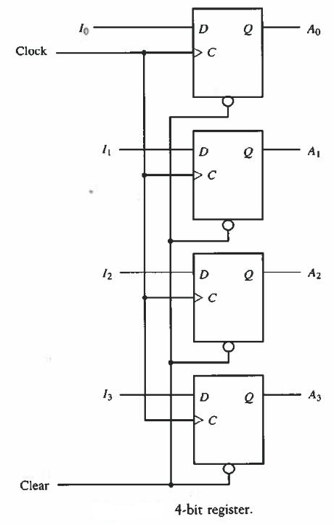
Register
Register

Slide 10
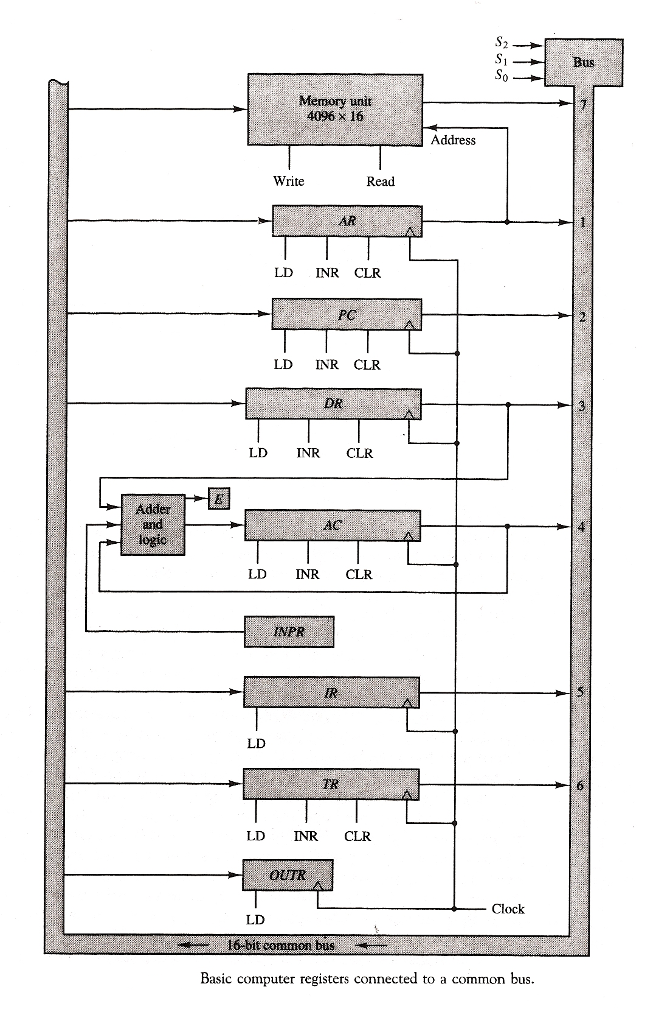
Bus and CPU
AR: address register
PC: program counter
DR: data register
AC: Arithmetic register
IR: Instruction register
TR: temporary register
INPR/OUTR: input/output register

Slide 11
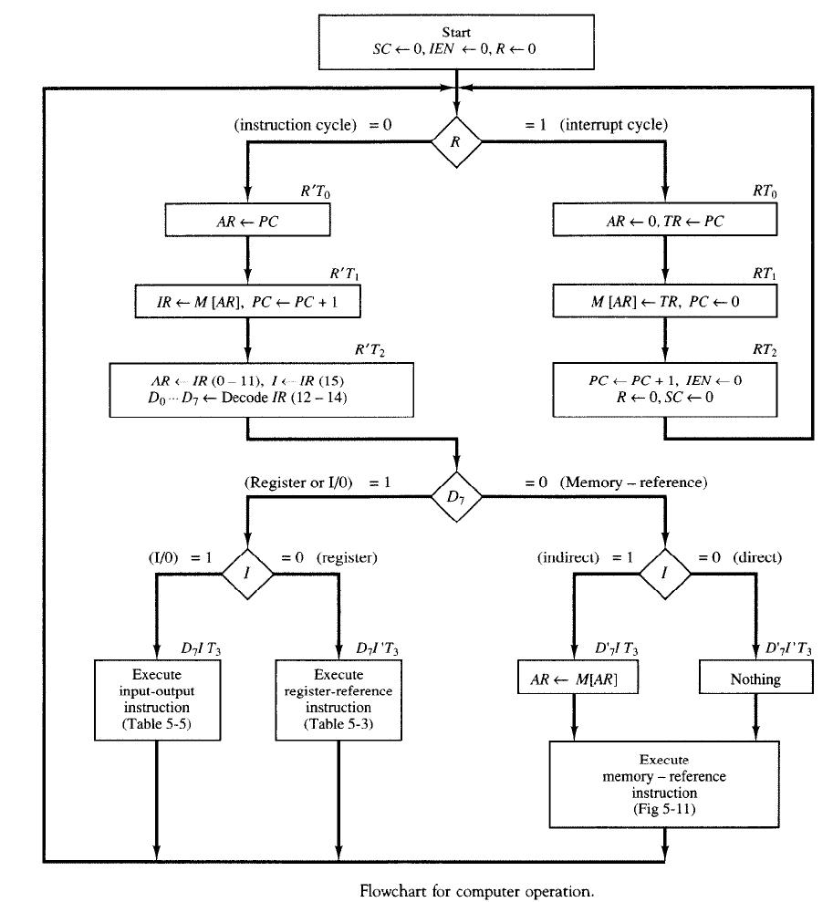
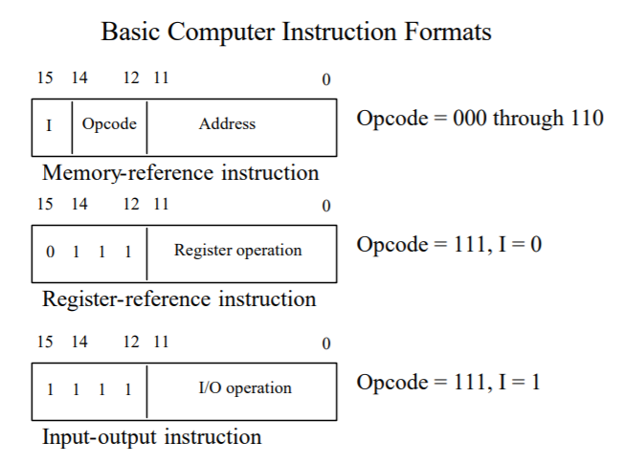
Computer Operation

Slide 12
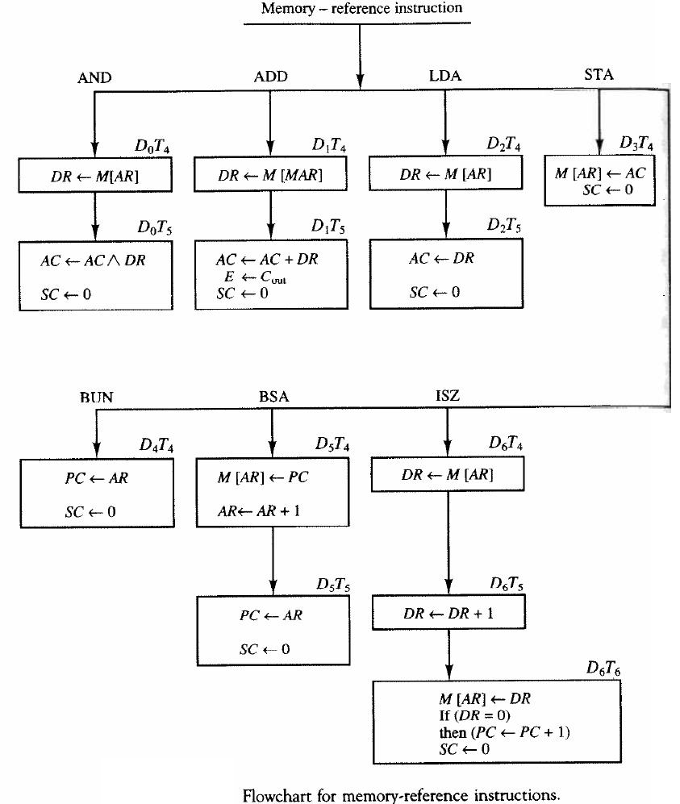
Memory-reference Instruction without DMA
ISZ: Increment and Skip if Zero
BSA: Branch and Save Return Address
BUN: Branch unconditionally
STA: Store AC

Slide 13
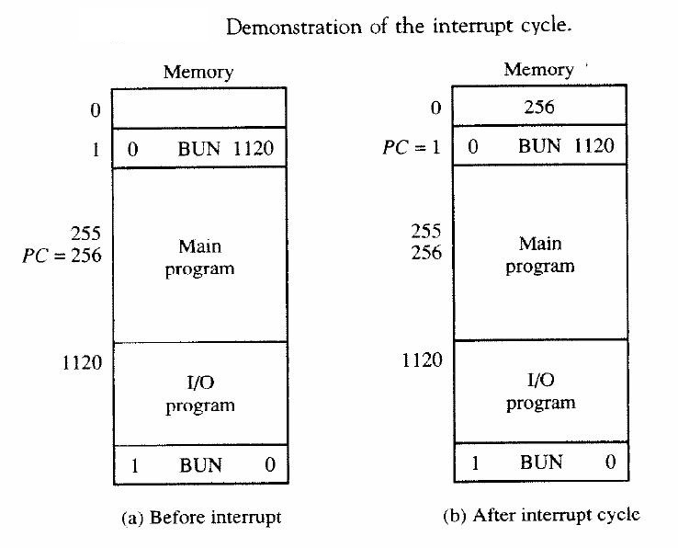
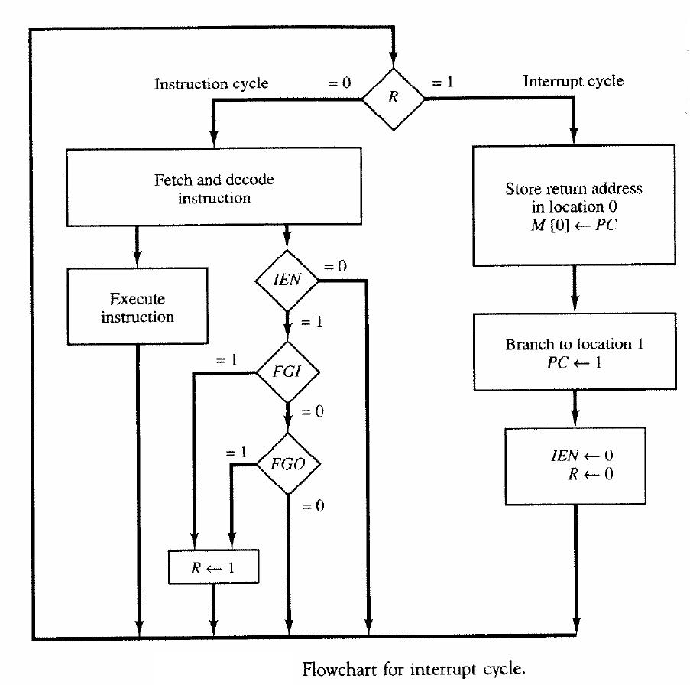
Interrupt and Handling

Slide 14
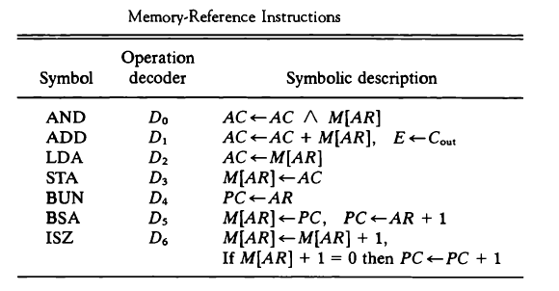
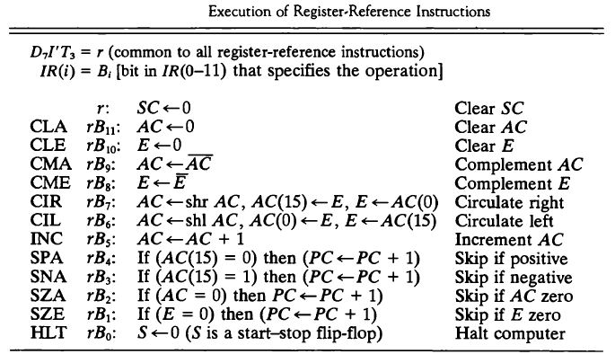

Slide 15
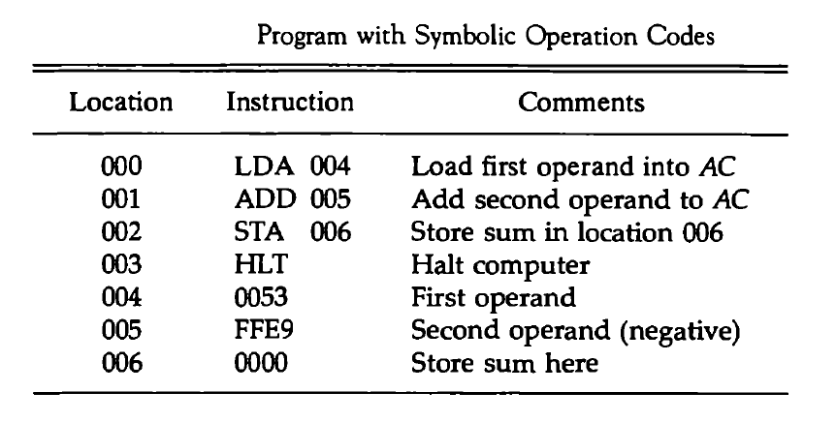
Example: Instruction Operation

Slide 16
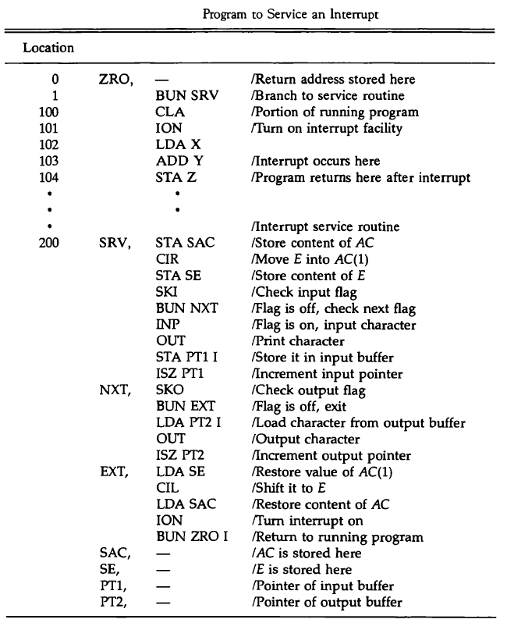
Example: Program to handle an interrupt

Slide 17
Common Functions of Interrupts
Interrupt transfers control to the interrupt service routine generally, through the interrupt vector, which contains the addresses of all the service routines
Interrupt architecture must save the address of the interrupted instruction
A trap or exception is a software-generated interrupt caused either by an error or a user request
An operating system is interrupt driven

Slide 18
Interrupt Handling
The operating system preserves the state of the CPU by storing registers and the program counter
Determines which type of interrupt has occurred:
Polling
It does not indicate which device. The interrupt controller must poll (send a signal out to) each device to determine which one made the request.
vectored interrupt system
Separate segments of code determine what action should be taken for each type of interrupt

Slide 19
Two I/O Structures
After I/O starts, control returns to user program only upon I/O completion
Wait instruction idles the CPU until the next interrupt
Wait loop (contention for memory access)
At most one I/O request is outstanding at a time, no simultaneous I/O processing
After I/O starts, control returns to user program without waiting for I/O completion
System call – request to the OS to allow user to wait for I/O completion
Device-status table contains entry for each I/O device indicating its type, address, and state
OS indexes into I/O device table to determine device status and to modify table entry to include interrupt

Slide 20
Direct Memory Access Structure
Used for high-speed I/O devices able to transmit information at close to memory speeds
Device controller transfers blocks of data from buffer storage directly to main memory without CPU intervention
Only one interrupt is generated per block, rather than the one interrupt per byte

Slide 21
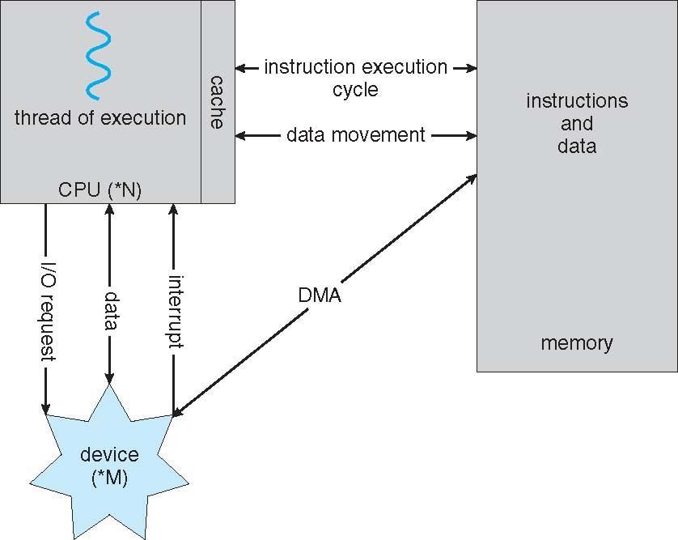
How a Modern Computer Works
A von Neumann architecture

Slide 22
End of Chapter 0

